Slide 1


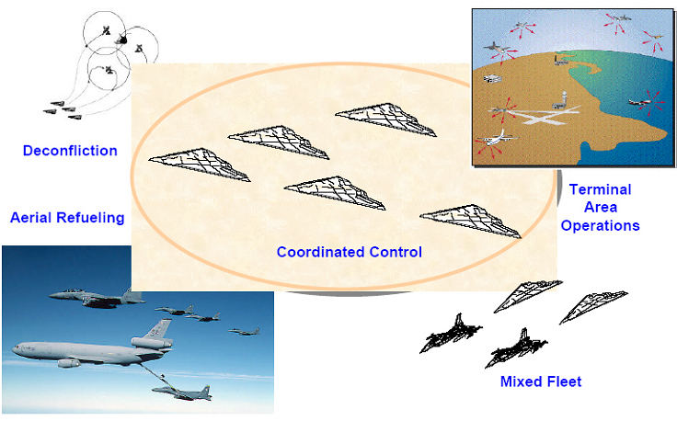
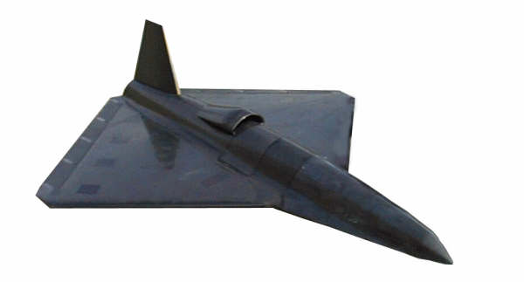
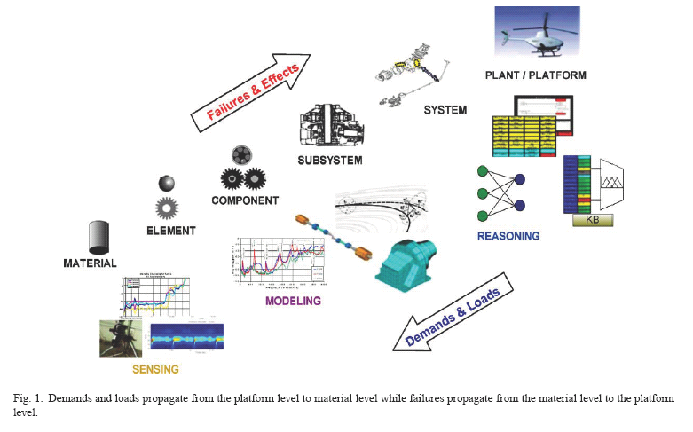

Coordinated Control, Integrated Control and
Condition Monitoring in Uninhabited Air-Vehicles
Ian Postlethwaite, Da-Wei Gu, Sarah Blaney, Kannan Natesan and Yoonsoo Kim
Environmental constraints
(targets, obstacles, threats)
Missions
Coordinated Control
Environmental
Condition Monitoring
& Active Model
High-Level Control
Formation determination
Cooperative observation/action
Internal
constraints
Commands
Internal
Condition Monitoring
& Active Model
Onboard Sub-optimal
Path Planning
Active states, uncertainties
dynamic parameters, faults, damage
Desired
trajectories/states
Environmental/
Distributed Sensors
Radar, vision, etc
Sensory data
Low-Level Control
Robust/adaptive control
The aim of this area of research is to develop algorithms for “optimal” task assignment and “safe” flight path selection in real-time for application in uncertain and hazardous environments.
We are focussing on real-time 3-D path planning algorithms for (multiple) UAVs working in three dimensions and making use of the following techniques: Voronoi graphs, Visibility graphs, mixed integer linear programming, extensive local search and a new approach called “bouncing”.
Vehicle Model
Nonlinear dynamics, engine model,
aero & atmospheric model
Actuators/
engine input
Condition Monitoring
We will develop fault detection mechanisms for use in a fault tolerant flight control system, which can automatically adapt for failures sustained during a mission thereby maintaining adequate flight performance and stability.
Integrated Control
KNOWLEDGE
BASE
Control surfaces
MODELLING
Distributed (virtual) Sensors
optimal controller
Demonstrator model
+ uncertainties
We will also explore the potential of multiple sensors (sensor arrays) distributed across an airframe to provide virtual air data for use in the health monitoring and improved control of future UAVs.
We will design and implement robust and optimal flight control systems for the Demonstrator. Primary flight controllers are to be integrated with engine control systems, condition monitoring and new actuators such as fluidic thrust vectoring and circulation control devices.
Progress and Plan for Next 12 Months
The work in the past year has been focussed on Coordinated Control and Integrated Control. A software package has been developed for the flight path planning task. The package incorporates several planning methods and is able to run in real-time and deal with uncertain situations. The package will be further developed in the near future to generate flight paths in 3-D. Algorithms for coordinated mission task planning are currently under development. Some initial robust control systems have been designed for the Demonstrator model. These designs will be extended to include the whole flight envelope. Control schemes which explore FTV (fluidic thrust vectoring) and CC (circulation control) actuators will be a major development. A health management/condition monitoring system is also planned

